Slide 1




KBHS
Building Resilience
Notes:
Facilitators NOTES:
ICE BREAKER: 2 x Optional Greeting Games.
1. Creepy Game - anonymously write down one creepy thing about you that no one knows. (give an example – eg one other school student said they kissed their cuzn)
(props: - Pen & Paper and a prize)
YES Collect Paper and Read Out answers– asking class if its creepy or normal.
Class votes the most creepiest……when the vote comes down to 1 finalist…..then YES will offer a PRIZE if the anonymous person reveals who they are.
2. Bingo Name game -.
Prep up by ensuring you have the A5 Bingo Cards & Pens.
Students are asked ask other students whether a box relates to them, and the write their name in the box - to walk around and find The 1 Student to tick all the boxes wins.

Slide 2
WHY ARE YOU HERE ?
Learn to Confront Fears: Rejection, Failure, Punishment, Shame.
Navigate challenges and while protecting your personal well-being and happiness.
Goal: Build Confidence - Emotional Strength to Fight the Good Fight.
Notes:
Like how you go to a gym for physical fitness – you come to FTGF for mental fitness.

Slide 3
RESPECT KORERO
RESPECT CONFIDENTIALITY
NOT JUDGEMENTAL
OPEN HONEST
Notes:
Everything is Confidential –(Create a safe place) - UNLESS its Unsafe, we have a duty of care to refer to professionals if we hear thing that are unsafe for the individual and also others.

Slide 4
RECAP
SESSION FIVE
Building Resilience

Slide 5
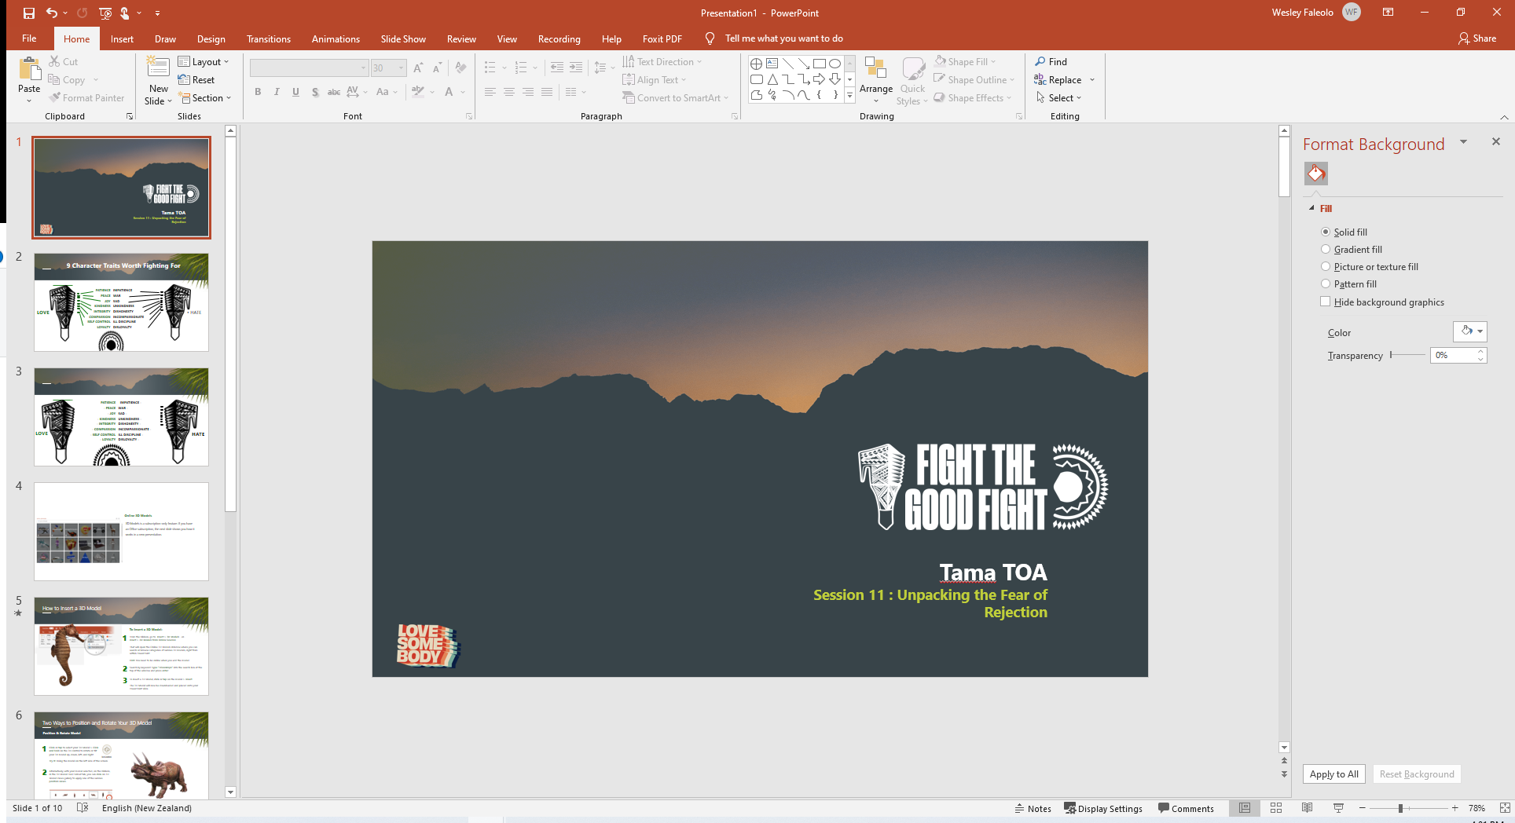


UNPACKING REJECTION
Session FIVE
SHAME
COUNTER TRAITS
RECAP
COMPASSION
Notes:
Anyone remember the first time they really felt rejection?

Slide 6
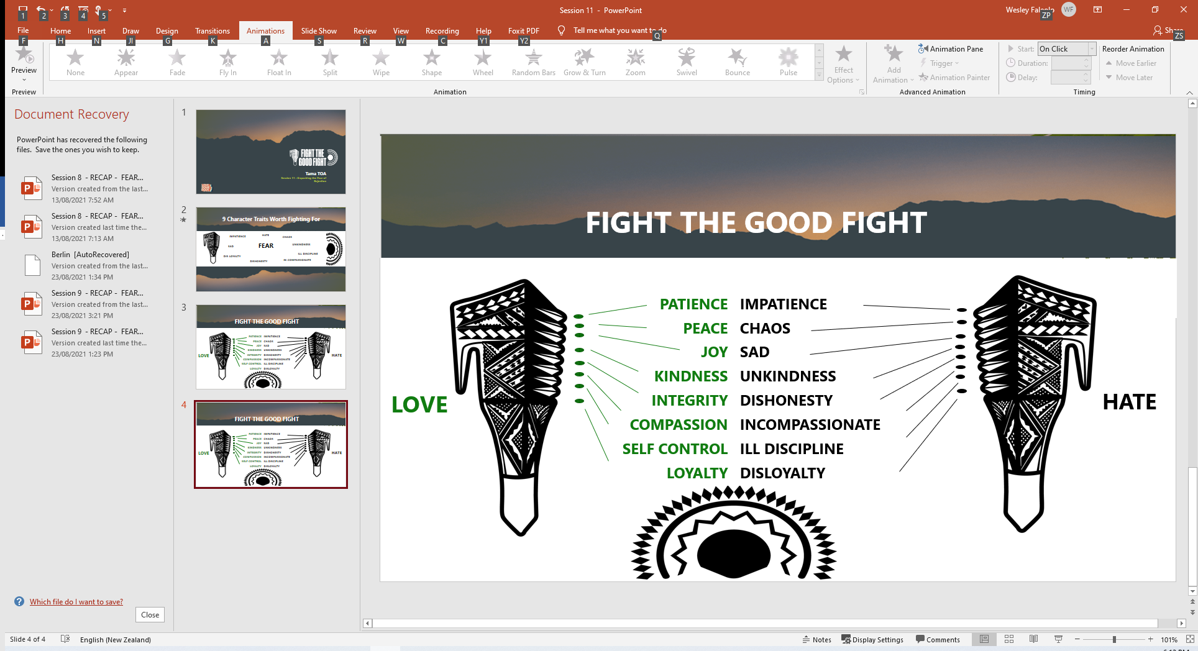
Counter Traits : PEACE
Chaos to Peace
Peace is a state of being calm at heart amidst all the chaos that surrounds it.
Real peace is the state of mind, not the state of the surroundings.
Peace can be defined as freedom from disturbance: tranquillity. Also, a state or period in which there is no war or war has ended
There are various other views on what peace is, and one common factor is the need to draw peace from a high source. To do so requires faith.
PEACE
RECAP
AROHA
Session Five: 1 of 22 Slides
Notes:
https://www.5lovelanguages.com/quizzes/love-language

Slide 7
Counter Traits : PEACE
Peace in Faith
This concept of peace and faith has been adapted by the world’s oldest and most successful addiction recovery programme, Alcoholics Anonymous.
The Serenity Prayer transcends well into the Maori and Pasifika language of understanding
E Te Atua tukua mai he ngaakau mahaki,(ki a matou) Kia tau tonu te Rangimarie I roto I nga uauatanga, Me te kaha ki te whakatika I nga marotanga ki a matou kia marama hoki I nga rereketanga.
Translated: “God grant me the serenity to accept the things I cannot change; courage to change the things I can; and the wisdom to know the difference. Thy will, not mine shall be
done. Amen.”
PEACE
RECAP
AROHA
Session Five: 2 of 22 Slides
Notes:
https://www.5lovelanguages.com/quizzes/love-language

Slide 8
Finding Inner Peace
Developing a peaceful state of mind is a process. The calm mind reveals itself as you work
towards it slowly and intentionally.
We can adopt known cultural practices and look at practical ways of finding peace.
Some of the main barriers to achieving a peaceful state of mind are the
Worries
Insecurities
Regrets
Frustration
RECAP
Session Five: 3 of 22 Slides
Notes:
Point 1 - Our IDENTITY – Who do we allow to say who we are? – THE Good Wolf or the BAD Wolf. – 4 Voices - Who do we hang out with.
Point 2 -
PAIN BUCKET ANALOGY – HURT PEOPLE HURT PEOPLE.

Slide 9
Finding Inner Peace
Mental strength and inner peace go hand in hand.
Finding inner peace requires willpower and determination.
Mentally prepared people find peace and are confident that they are ready to handle
whatever life throws their way. That’s not to say they don’t feel pain or that they don’t get sad.
RECAP
Session Five: 4 of 22 Slides
Notes:
Point 1 - Our IDENTITY – Who do we allow to say who we are? – THE Good Wolf or the BAD Wolf. – 4 Voices - Who do we hang out with.
Point 2 -
PAIN BUCKET ANALOGY – HURT PEOPLE HURT PEOPLE.

Slide 10
Finding Inner Peace
Peaceful People experience their emotions on a deep level. But they don’t misplace energy, wishing
things were different or trying to change other people.
They stay focused on managing their thoughts, feelings, and behaviours.
Making self-improvements is an excellent start because there is always room for improvement.
RECAP
Session Five: 5 of 22 Slides
Notes:
Point 1 - Our IDENTITY – Who do we allow to say who we are? – THE Good Wolf or the BAD Wolf. – 4 Voices - Who do we hang out with.
Point 2 -
PAIN BUCKET ANALOGY – HURT PEOPLE HURT PEOPLE.

Slide 11
Finding Inner Peace
Here are 10 things mentally prepared people give up to find inner peace.
Engaging with toxic people:
The people we surround ourselves with affect the way we think, feel, and behave.
Engaging with people who lie, gossip, bully, or cheat takes a toll on our well-being.
It is important not to spend all our energy trying to change toxic people. Establish healthy emotional and physical boundaries
2. Excessive self-blame:
Thinking everything is 100 percent our fault (whether it's a failed relationship or an accident) will affect the way we see ourselves and the world around us.
We can't always prevent bad things from happening. We need to take appropriate accountability.
We should recognize others are responsible for their choices, and we should acknowledge factors that are beyond our control-like the state of the economy, the weather, and other people’s choices
RECAP
Session Five: 6 of 22 Slides

Slide 12
Finding Inner Peace
Here are 10 things mentally prepared people give up to find inner peace.
3. Chasing Happiness:
Thinking we need to be happy all the time will backfire on us. Momentary pleasure is very
different to long-term satisfaction.
Peaceful people are willing to put in the hard work it takes to gain contentment.
They refuse to give in to instant gratification or temporary indulgences.
They look for ways to build a brighter future by creating long-term goals
4. Staying comfortable:
It may seem like staying inside our comfort zone is the key to feeling good in life.
But avoiding discomfort always backfires in the end. Peaceful people face their fears, venture
into unknown areas, and test their limits.
They know that being uncomfortable is tolerable and allowing themselves to experience
discomfort is the key to living a better life.
RECAP
Session Five: 7 of 22 Slides

Slide 13
Finding Inner Peace
Here are 10 things mentally prepared people give up to find inner peace.
5. The Victim Mentality:
Thinking the world and the people in it are out to get us will prevent us from being our best. In fact, if we blame all of our problems on external circumstances, we'll never take responsibility for our own lives.
Peacefully strong people acknowledge their choices, even in the face of tragic circumstances.
They focus on the things they can control, and they refuse to waste their time hosting pity parties.
6. Trying to Impress people:
We could waste a lot of our lives trying to make people like us. Depending on admiration from others gives them power over us.
Peaceful people are comfortable in their own skin. They don't waste their time worrying about whether other people approve of their choices.
Instead, they focus on living according to their values.
RECAP
Session Five: 8 of 22 Slides

Slide 14
Finding Inner Peace
Here are 10 things mentally prepared people give up to find inner peace.
7. The Pursuit of Perfection:
Striving for excellence is healthy. But insisting on perfection is a recipe for heartache and failure.
You'll never feel good enough if you set the bar impossibly high.
Peaceful people accept that they're going to fail and make mistakes.
They are able to acknowledge their flaws and weaknesses and position themselves to learn from their mistakes
8. Grudges:
We may think holding onto a grudge somehow punishes someone else. But, in reality, clinging
to anger and hatred only reduces our lives.
Peaceful people let go of grudges so they can focus their energy on more worthwhile causes.
That doesn't mean they allow themselves to be abused by people, however. It just means they
don't allow pent-up resentment to overtake their lives.
RECAP
Session Five: 9 of 22 Slides

Slide 15
Finding Inner Peace
Here are 10 things mentally prepared people give up to find inner peace.
9. The quest for material things:
No matter how much money we make, a bigger house, a nicer car, or more expensive clothing won't give you peace of mind.
Expecting material possessions to satisfy our needs will leave us sorely disappointed.
Peaceful people aren't necessarily minimalists, however. They can enjoy nice things. But they
don't expect their material possessions to give them joy and contentment
10. Complete self-reliance:
Thinking we can do everything on our own is about acting tough-not being strong. There will be times when asking for help is important.
Peaceful people aren't afraid to admit when they need help. Whether they rely on a higher power, ask for professional help, or lean on a friend during a time in need, they gain strength from others.
Knowing they don't have to have all the answers gives them a renewed sense of inner peace.
RECAP
Session Five: 10 of 22 Slides

Slide 16

UNPACKING REJECTION
COUNTER TRAITS
RECAP
Remaining Traits we be covered in sessions ahead.
AROHA

Slide 17
RECAP
SESSION FIVE – PART 2:
Building Resilience
Session Three : 12 of 22 Slides

Slide 18
THE FEAR OF SHAME
Inferiority or feeling Sub-standard
By definition shame is a deep sense of inferiority.
Feelings of inferiority can result from long patterns of failure, or come from only one or two haunting instances.
Either way, they can destroy our self-worth, and as a result, affect our emotions and behaviour.
This perception of ourselves are not easily altered, but can change through honesty, the support of others, encouragement and knowing we are loved, accepted, and still complete
RECAP
Which character traits will help us build our self-worth? Identify behaviours that can work against it.
Session Five: 13 of 22 Slides

Slide 19
THE FEAR OF SHAME
Destructive Behaviour Habit
We often behave in a manner that is consistent without perception of
ourselves. Seeing ourselves through the eyes of shame usually results
in a negative outlook on life and a lifestyle of destructive behaviour
RECAP
Discuss which Character Traits will help us to counter the above coping mechanisms and state why?
Session Five: 14 of 22 Slides

Slide 20
THE FEAR OF SHAME
Despising our Appearance
- Beauty is highly valued in our society. Social media and TV all convey this message that beauty is to be prized.
- But very few of us compare to the beautiful people we see in these ads and television.
- Most of us are ashamed of at least one aspect of our appearance.
- We spend a large amount of time, money and worry covering up what we see as defects.
- Instead of focusing on the beauty we do have, and developing confidence in who we are, we can end up in an endless cycle to keep our appearance in check to those who approve.
RECAP
Discuss which Character Traits will help counter the above coping mechanisms and state why?
Session Five: 15 of 22 Slides
Notes:
Start Session 6 HERE

Slide 21
THE FEAR OF SHAME
Self Pity
Shame often prompts us to view ourselves as victims. As a result,
whether we blame others or condemn ourselves for our actions, we
sink into depths of feeling sorry for ourselves
RECAP
Discuss which Character Traits will help counter the above coping mechanisms and state why?
Session Five: 16 of 22 Slides

Slide 22
THE FEAR OF SHAME
Inactivity – Isolation and Withdrawal
Inactivity
Some of us try to compensate for troubling feelings of shame
through inactivity, refusing to invest any part of ourselves in relationships and responsibilities.
We may be compulsive perfectionists in some areas of our lives,
but may avoid taking risks in relationships or circumstances. We may tend to want to become “too busy” to experience the reality of relationships and situations
Isolation and Withdrawal
Avoiding both the risks of rejection and failure, some of us withdraw from virtually all meaningful interaction.
We develop fronts, so that nobody can see our hurt.
We may be socially inactive, but may not allow anyone to get really close to us.
We are often afraid if people really knew us, we would again experience hurt and rejection.
Our deep sense of shame leads us to withdraw from others, feel isolated, and experience the pain of loneliness.
RECAP
Session Five: 17 of 22 Slides

Slide 23
THE FEAR OF SHAME
Loss of Creativty – Co-dependancy
Loss of Creativity
When we are ashamed of ourselves over a period of time, the cutting edge of our creativity withers.
We tend to become so preoccupied with our own inferiority that we are unable to come up with new ideas.
Often believing that whatever we attempt will fail, we may choose to avoid doing anything that isn’t a proven success and is risk-free.
Co-dependant Relationships
they develop a need to “rescue” and take care of others. This caretaking is the subconscious way of trying to gain personal significance.
It can backfire, when the dependant person starts controlling you, like saying why are you taking care of other people and not me.
This locks the co-dependent into a hopeless pattern of rescuing to gain approval and feeling ashamed because of his or her inability to develop a sense of personal value, regardless how hard he or she tries to do so
RECAP
Session Five: 18 of 22 Slides

Slide 24
THE FEAR OF SHAME
Anxieties
I often think about past failures or experiences of rejection | There are certain things about my past which I cannot recall without getting strong, painful emotions (ie guilt, shame, anger, fear etc)
RECAP
I seem to make the same mistakes over and over again. | There are certain aspects of my character that I want to change, but I don’t believe I can ever successfully do so.
I feel inferior or sub-standard | There are parts of my appearance that I cannot accept.
I am generally disgusted with myself. | I feel that certain experiences have basically ruined my life
I see of myself as an immoral person. | I feel that I have lost the opportunity to experience a complete and wonderful life.
Discuss which Character Traits will help counter the above anxieties
Session Five: 19 of 22 Slides

Slide 25
UNPACKING OUR FEARS
SESSION SIX
PUNISHMENT
COMPASSION

Slide 26
THE FEAR of PUNISHMENT
BLAME GAME
LETS GUESS YOUR SKIT – ARE THEY ACTING OUT “A” – “B” – “C” – “D”?
If we’ve experienced or seen punishment from failures, we can create a view that those who fail will receive a form of deserved punishment
We can put our guard up and divert failure by pointing the blame of failure elsewhere and tell ourselves,
‘it isn’t my fault’.
Redirecting blame and failure to others can make us feel superior.
D. Our attempts to divert blame can make us susceptible to other more undesirable tendencies such as dishonesty
CREATE A SKIT from the Letter Allocated to your Group
Session Six : 2 or 11 Slides
Notes:
Point 1 - Our IDENTITY – Who do we allow to say who we are? – THE Good Wolf or the BAD Wolf. – 4 Voices - Who do we hang out with?
Point 2 - PAIN BUCKET ANALOGY – HURT PEOPLE HURT PEOPLE.

Slide 27

THE FEAR of PUNISHMENT
BLAME GAME
“One-Up”
Session Six : 2 or 11 Slides

Slide 28
THE FEAR of PUNISHMENT
BLAME GAME
LETS GUESS YOUR SKIT – ARE THEY ACTING OUT “A” – “B” – “C” – “D”?
Preserving our sense of self and a fear of punishment can also lead us to always be “one-up”
on another person.
When we do better than someone else, it makes us feel good and helps us avoid trouble.
But this happiness doesn't last long because someone else might do better. Thinking we're always right and others are always wrong can lead to gossip. It can also make us feel jealous, treat others unfairly, or not want to help them.
Sometimes, when we cannot find someone or something to blame, we can blame ourselves.
CREATE A SKIT from the Letter Allocated to your Group
Session Six : 2 or 11 Slides

Slide 29
THE FEAR of PUNISHMENT
Q & A:: BLAME GAME
If we are told we are a constant failure and accept this belief, we develop flawed and faulty views of ourselves and we can punish ourselves and others.
Thoughts such as, ‘Get out of my face or I’ll hurt you, I never get it right, I don’t deserve this, why do I bother’, can send many of us into a mental battle and a slow downward spiral.
Q: What 2 Voices are in this Statement?
A: Other Peoples BAD Voice – My own BAD Voice
Q: What type of people would say : Get out of my face or I’ll hurt you?
Q: Name the Voice or Wolf in this Statement.
A: Hurt People (Bucket Overflowing)
A: My own BAD Voice
Q: Where can the Slow Downward Spiral Lead us to?
A: Depression , Self Harm and DBH
Session Six : 3 or 11 Slides

Slide 30
THE FEAR of PUNISHMENT
Q & A:: BLAME GAME
Question: Why do we sometimes feel that people who fail, including ourselves, don't deserve love and should be punished?
Read as CLASS
Answer: Failing doesn't mean we deserve punishment or lose love; everyone makes mistakes, and they help us learn and grow.
Session Six : 3 or 11 Slides

Slide 31
THE FEAR OF PUNISHMENT
Does this FEAR impact us TODAY?
1 | 2 | 3 | 4 | 5 | 6 | 7
Always | Very Often | Often | Sometimes | Not Often | Hardly | Never
1. I fear what life has for me.
2. After I fail, I worry about having something negative happen.
3. When I see someone in a difficult situation, I wonder what he or she did to deserve it.
4. When I do something wrong, I have a tendency to think that the universe must be punishing me.
5. I am very hard on myself when I fail.
6 . I find myself wanting to blame people when they fail.
7. I get angry when someone who is immoral or dishonest prospers
8. I am compelled to tell others when I see them doing wrong.
9. I tend to focus on the faults and failures of others.
10. Life seems harsh on me.
Session Six : 4 or 11 Slides

Slide 32
Interpretation of Score
57-70
You seem to be free from the fear of punishment that plagues most people. (Some people who score this high are either greatly deceived or have become callous to their emotions as a way to suppress pain).
47-56
The fear of punishment and the compulsion to punish others controls your responses rarely or only in certain situations. Again, only the major exceptions are those who are not honest with themselves.
37-46
When you experience emotional problems, they may relate to a fear of punishment or an inner urge to punish others. Upon reflection, you will probably relate many of your previous decisions to this fear. Many of your future decisions will also be affected by the fear of punishment and/or the compulsion to punish others unless you take direct action to overcome it.
27-36
The fear of punishment forms a general backdrop to your life. There are probably a few days that you are not affected somehow by the fear of punishment and the tendency to blame others. Unfortunately, this robs you of the joy and peace to which you are entitled.
0-26
Experiences of punishment dominate your memory, and you have probably suffered a great deal of depression due to them. These problems will remain until some definitive action is taken. In other words, this condition will not simply disappear: time alone cannot heal your pain. You need to experience deep healing in your self-concept and your relationship with others.
Session Six : 5 or 11 Slides

Slide 33
END OF SESSION SIX
Building Resilience

