Slide 1




KBHS
Building Resilience
Notes:
Facilitators NOTES:
ICE BREAKER: 2 x Optional Greeting Games.
1. Creepy Game - anonymously write down one creepy thing about you that no one knows. (give an example – eg one other school student said they kissed their cuzn)
(props: - Pen & Paper and a prize)
YES Collect Paper and Read Out answers– asking class if its creepy or normal.
Class votes the most creepiest……when the vote comes down to 1 finalist…..then YES will offer a PRIZE if the anonymous person reveals who they are.
2. Bingo Name game -.
Prep up by ensuring you have the A5 Bingo Cards & Pens.
Students are asked ask other students whether a box relates to them, and the write their name in the box - to walk around and find The 1 Student to tick all the boxes wins.

Slide 2
WHY ARE YOU HERE ?
Learn to Confront Fears: Rejection, Failure, Punishment, Shame.
Navigate challenges and while protecting your personal well-being and happiness.
Goal: Build Confidence - Emotional Strength to Fight the Good Fight.
Notes:
Like how you go to a gym for physical fitness – you come to FTGF for mental fitness.

Slide 3
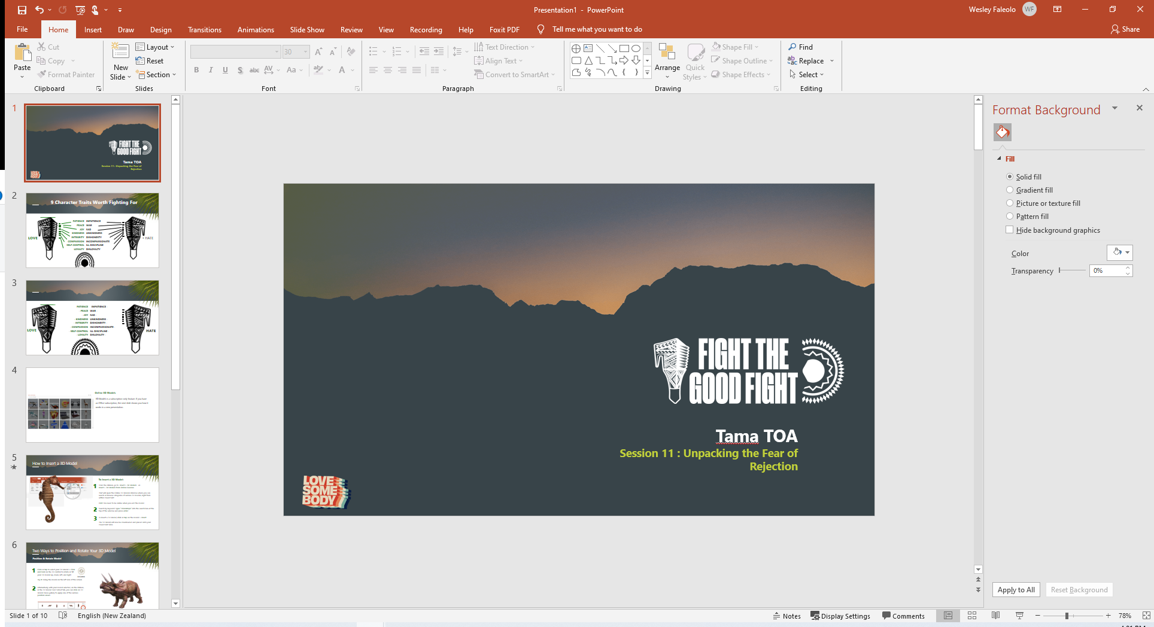
TERM TOPICS
Term ONE - TWO
The Battle
Term TWO – THREE
The Fear of SHAME
Term THREE - FOUR
The Fear of FAILURE
The Fear of REJECTION
Impacts on Our Slice of Heaven
Impacts on Our Slice of Heaven
The Content
Impacts on Our Slice of Heaven
The Fear of PUNISHMENT
Summary / Love Languages
Impacts on Our Slice of Heaven
COMPASSION

Slide 4
Notes:
The schools that profiled students to – elaborate on what FTGF is about.

Slide 5
RESPECT KORERO
RESPECT CONFIDENTIALITY
NOT JUDGEMENTAL
OPEN HONEST
Notes:
Everything is Confidential –(Create a safe place) - UNLESS its Unsafe, we have a duty of care to refer to professionals if we hear thing that are unsafe for the individual and also others.

Slide 6


The BATTLE
WHY AM I FIGHTING?
WHO AM I FIGHTING?
WHO DETERMINES THE BATTLE?
WHAT DOES WINNING DO FOR ME?
WHAT HAPPENS IF WE LOSE?
WHO AM I IN THE BATTLE?
COMPASSION
Session One: 6 of 22 Slides
Notes:
What are the first things you think of when you are in a battle.

Slide 7
The Battle
WHY AM I FIGHTING?
WHO AM I FIGHTING?
WHO DETERMINES THE BATTLE?
WHAT DOES WINNING DO FOR ME?
WHAT HAPPENS IF WE LOSE?
WHO AM I IN THE BATTLE?
COMPASSION
Session One: 8 of 22 Slides
Notes:
What are the first things you think of when you are in a battle.

Slide 8
THE BATTLE GROUND?
FIELD OF EMOTIONS
SOURCED BY 4 VOICES
OUR OWN VOICE
OTHER PEOPLES VOICE
GOOD VOICE
BAD VOICE
CAN BE INTENSE IF WE CANT FILTER OUT THE VOICES
THE GOOD THING IS WE CAN FILTER IT
COMPASSION
Session One: 9 of 22 Slides
Notes:
Slide 9: (consider providing imagery and vid clips to reflect this ) – then replace this screen)

Slide 9
The BATTLE OF THE MIND
WHY AM I FIGHTING?
WHO AM I FIGHTING?
WHO DETERMINES THE BATTLE?
WHAT DOES WINNING DO FOR ME?
WHAT HAPPENS IF WE LOSE?
WHO AM I IN THE BATTLE?
COMPASSION
Session One: 10 of 22 Slides

Slide 10
Who is in THE BATTLE?
There is an old Native American story about two wolves.
In this story, a chief is asked,
‘Which of the two wolves would win if they battled each other?
The good wolf or the bad
wolf?’
The chief answered,
‘The wolf you feed well will win the battle.
COMPASSION
Session One: 11 of 22 Slides
Notes:
Ask Students WHO will Win the Fight:
Everyone has a Good wolf and a Bad Wolf

Slide 11
WHO AM I IN THE BATTLE?
AM I GOOD ENOUGH TO WIN THE BATTLE?
WILL I BE ABLE TO KNOW WHAT WOLF TO FEED - WHEN GOOD LOOKS BAD AND BAD LOOKS GOOD?
COMPASSION
Session One: 12 of 22 Slides

Slide 12
WHO AM I IN THE BATTLE?
YES - I AM GOOD ENOUGH!!!
COMPASSION
Session One: 13 of 22 Slides

Slide 13
The BATTLE is REAL
ILLUSTRATION on HOW STRONG OUR MIND IS.
Placebo Effect – it’s the research from giving a mentally challenged patient a sugar pill with
no active properties in the pill that will help him get better.
The patient takes the pill not knowing it has no effect ,believing
it will heal him. Their belief in turn, heals them.
We have a
POWERFUL MIND.
FOCUSING ON PROTECTING YOUR
SLICE OF HEAVEN
IDENTIFY WAYS TO PROTECT OUR SLICE OF HEAVEN.
Session ONE: 14 of 22 Slides
Notes:
OUR NEXT SESSION TWO WILL IDENTIFY WHATS IN THE WAY

Slide 14
What is your Slice of Heaven?
Constant JOY
Achievement
Sweet Spot
SLICE OF HEAVEN
Fruits of Labour
Love & Peace
Happy Home
INTEGRITY
All the GOOD STUFF
Place of Contentment
COMPASSION
Session One: 15 of 22 Slides

Slide 15
What is your Slice of Heaven?
SLICE OF HEAVEN
REWARD
STATE OF MIND
IS BOTH
AND BOTH NEED
PROTECTING
COMPASSION
Session One: 16 of 22 Slides
Notes:
Course can be a warrant of fitness - where are we today ?
Learn of Unlearn?
Be reminded on things you know.

Slide 16
9 Character Traits Worth Fighting For
LOVE
IMPATIENCE
HATE
PATIENCE
PEACE
CHAOS
SLICE of HEAVEN
???
FEAR
KINDNESS
SAD
UNKINDNESS
JOY
ILL-DISCIPLINE
SELF CONTROL
DIS-LOYALTY
LOYALTY
IN-COMPASSIONATE
INTEGRITY
COMPASSION
DISHONESTY
COMPASSION
Session One: 17 of 22 Slides

Slide 17
PATIENCE | IMPATIENCE
PEACE | CHAOS
JOY | SAD
KINDNESS | UNKINDNESS
INTEGRITY | DISHONESTY
COMPASSION | INCOMPASSIONATE
SELF CONTROL | ILL DISCIPLINE
LOYALTY | DISLOYALTY
AROHA
HATE

Slide 18
UNPACKING OUR FEARS
PUNISHMENT
FAILURE
FEAR
SHAME
REJECTION
COMPASSION
Session One: 19 of 22 Slides

Slide 19
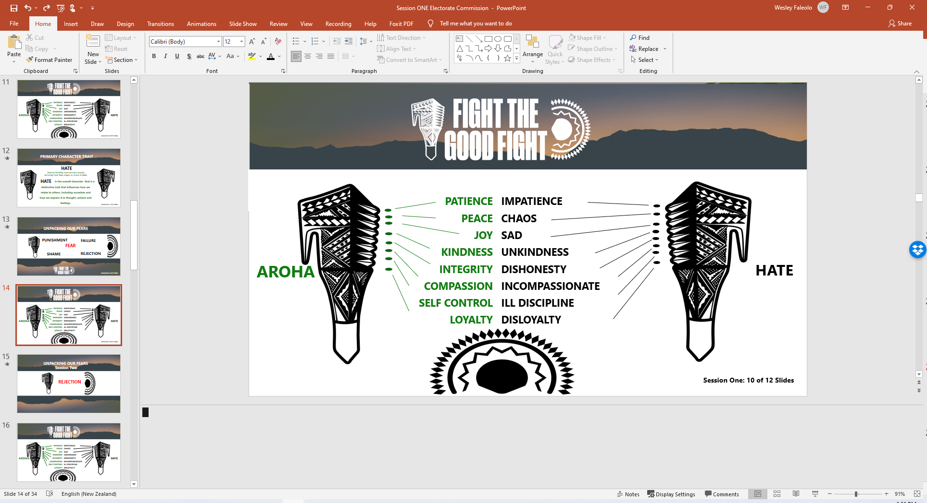
WHATS COMING UP - REJECTION
Session One: 20 of 22 Slides

Slide 20
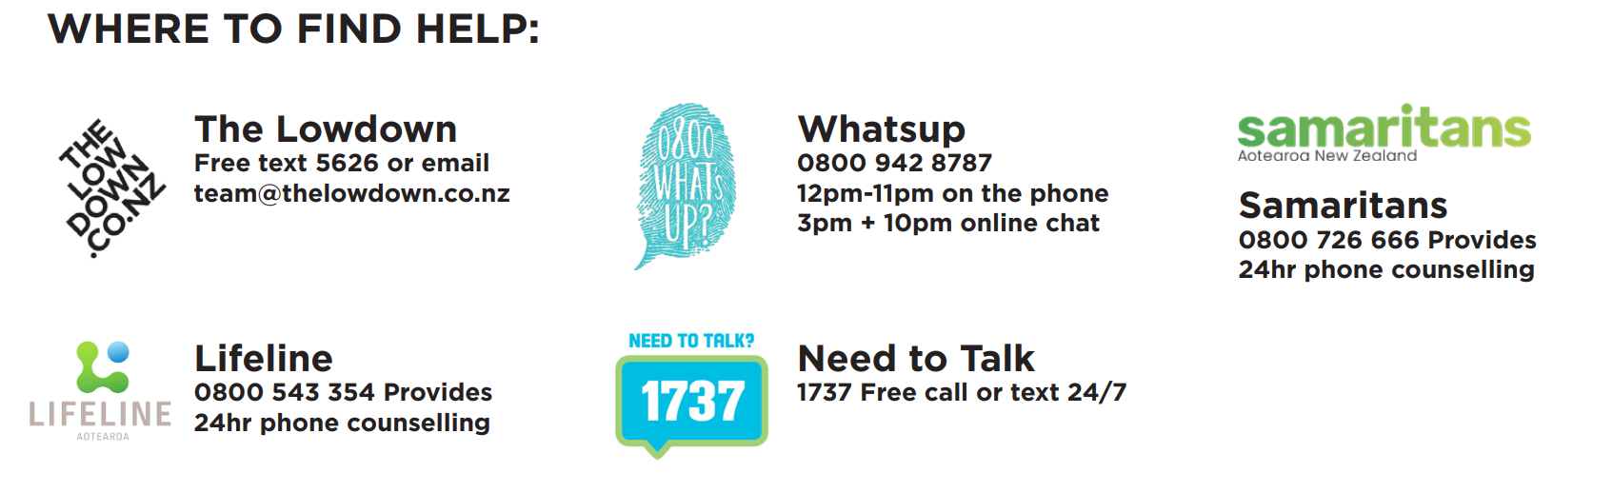
9 Character Traits Worth Fighting For
COMPASSION
Session One: 21 of 22 Slides

Slide 21
END OF SESSION ONE
Building Resilience
Session One: 22 of 22 Slides

